Slide 1
Module name: ADAPTIVE SOCIAL PROTECTION
Session name: CASE STUDY
Analysis to Action:
An Executive Education Program on Disaster Risk Finance in Africa
2 – 6 September 2019
Stellenbosch University

Slide 2
Module: ADAPTIVE SOCIAL PROTECTION
CASE STUDY SESSION - OVERVIEW
    15 MINS
        READ THE CASE STUDY AND REFLECT ON THE WORKSHEET
    30 MINS
        GROUP DISCUSSSIONS ON PILOT PROGRAMME OUTLINE
    30 MINS
        GROUP FEEDBACK AND PRESENTATIONS ON PILOT PROGRAMME OUTLINE
    15 MINS
        WRAP-UP AND KEY LEARNINGS

Slide 3
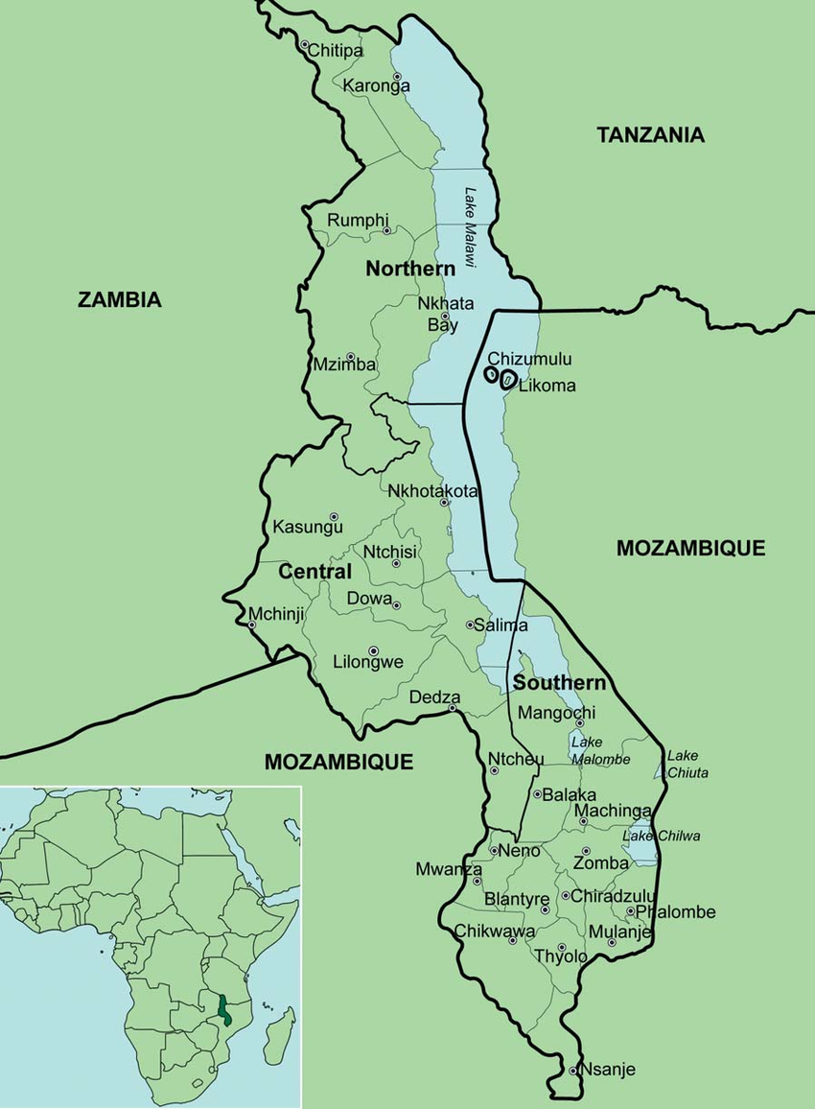
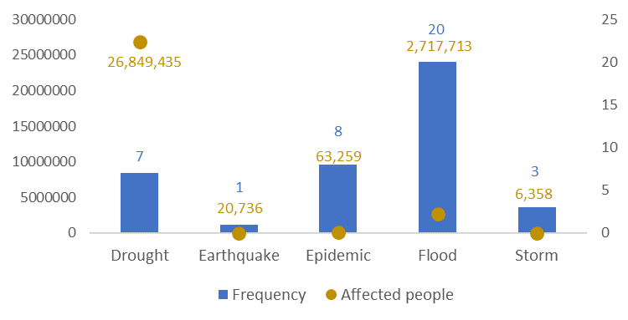
Module: ADAPTIVE SOCIAL PROTECTION
DESIGNING A SHOCK-RESPONSIVE SOCIAL PROTECTION PILOT PROGRAMME IN MALAWI:
TARGET AREAS
DATA AND DESIGN
ESTIMATED COSTS AND FINANCING INSTRUMENTS
KEY DISASTER RISKS

Slide 4
Module: ADAPTIVE SOCIAL PROTECTION
DESIGNING A SHOCK-RESPONSIVE SOCIAL PROTECTION PILOT PROGRAMME IN MALAWI:
CASE-STUDY CHALLENGE
Policy Priorities Define the Design of the Pilot Programme
DISCUSSION GROUPS:
  MINISTRY OF FINANCE
  SOCIAL PROTECTION MINISTRY
  DEVELOPMENT BANK
KEY DISASTER RISKS
TARGET AREAS
DATA AND DESIGN
ESTIMATED COSTS AND FINANCING INSTRUMENTS
LIMITED FUNDING!!

Slide 5
Module: ADAPTIVE SOCIAL PROTECTION
DESIGNING A SHOCK-RESPONSIVE SOCIAL PROTECTION PILOT PROGRAMME IN MALAWI:
GROUP FEEDBACK:
KEY DISASTER RISKS
TARGET AREAS
DATA AND DESIGN
ESTIMATED COSTS AND FINANCING INSTRUMENTS

Slide 6




Module: ADAPTIVE SOCIAL PROTECTION
Six Steps Towards Strengthening Financial Resilience
    Finalize the mechanism rules and devise a DRF strategy to support costs
    Design the Scalability
    Mechanism
    Develop a risk profile
1
2
3
4
5
6
    Decide on policy priorities
    Estimate the cost of
    Scalability mechanism
    Monitoring and Evaluation

Slide 7
Module: ADAPTIVE SOCIAL PROTECTION
BUILDING BLOCKS
    Information systems and targeting
        Determine the amount of assistance needed
        Identify affected populations to receive the assistance
    Risk information and early warning system
    Where vulnerable households are located
    When and for how long the delivery mechanism will scale up
    Delivery mechanism
        How assistance will be channeled to affected population
    Disaster
    Risk Financing
    How much the mechanism could cost, and develop appropriate strategies to finance response, with clarity on who pays.
    Institutional coordination
    How does the social protection scale ups complement disaster response and humanitarian assistance.

